Slide 1

Chapter 7:
Arrays

Slide 2
7.5
The Range-Based for Loop

Slide 3

The Range-Based for Loop
C++ 11 provides a specialized version of the for loop that, in many circumstances, simplifies array processing.
The range-based for loop is a loop that iterates once for each element in an array.
Each time the loop iterates, it copies an element from the array to a built-in variable, known as the range variable.
The range-based for loop automatically knows the number of elements in an array.
  You do not have to use a counter variable.
  You do not have to worry about stepping outside the bounds of the array.

Slide 4
The Range-Based for Loop
Here is the general format of the range-based for loop:
dataType is the data type of the range variable.
rangeVariable is the name of the range variable. This variable will receive the value of a different array element during each loop iteration.
array is the name of an array on which you wish the loop to operate.
statement is a statement that executes during a loop iteration. If you need to execute more than one statement in the loop, enclose the statements in a set of braces.
for (dataType rangeVariable : array)
statement;

Slide 5
The range-based for loop in Program 7-10
// This program demonstrates the range-based for loop.
#include <iostream>
using namespace std;
int main()
{
// Define an array of integers.
int numbers[] = { 10, 20, 30, 40, 50 };
// Display the values in the array.
for (int val : numbers)
cout << val << endl;
return 0;
}

Slide 6
Modifying an Array with a Range-Based for Loop
As the range-based for loop executes, its range variable contains only a copy of an array element.
You cannot use a range-based for loop to modify the contents of an array unless you declare the range variable as a reference.
To declare the range variable as a reference variable, simply write an ampersand (&) in front of its name in the loop header.
Program 7-12 demonstrates

Slide 7
Modifying an Array with a Range-Based for Loop in Program 7-12
const int SIZE = 5;
int numbers[5];
// Get values for the array.
for (int &val : numbers)
{
cout << "Enter an integer value: ";
cin >> val;
}
// Display the values in the array.
cout << "Here are the values you entered:\n";
for (int val : numbers)
cout << val << endl;

Slide 8
Modifying an Array with a Range-Based for Loop
You can use the auto key word with a reference range variable. For example, the code in lines 12 through 16 in Program 7-12 could have been written like this:
for (auto &val : numbers)
{
cout << "Enter an integer value: ";
cin >> val;
}

Slide 9
The Range-Based for Loop versus the Regular for Loop
The range-based for loop can be used in any situation where you need to step through the elements of an array, and you do not need to use the element subscripts.
If you need the element subscript for some purpose, use the regular for loop.

Slide 10
7.6
Processing Array Contents

Slide 11
Processing Array Contents
Array elements can be treated as ordinary variables of the same type as the array
When using ++, -- operators, don’t confuse the element with the subscript:
  tests[i]++; // add 1 to tests[i]
  tests[i++]; // increment i, no
  // effect on tests

Slide 12
Array Assignment
To copy one array to another,
Don’t try to assign one array to the other:
  newTests = tests; // Won't work
Instead, assign element-by-element:
  for (i = 0; i < ARRAY_SIZE; i++)
  newTests[i] = tests[i];

Slide 13
Printing the Contents of an Array
You can display the contents of a character array by sending its name to cout:
char fName[] = "Henry";
  cout << fName << endl;
  But, this ONLY works with character arrays!

Slide 14
Printing the Contents of an Array
For other types of arrays, you must print element-by-element:
  for (i = 0; i < ARRAY_SIZE; i++)
  cout << tests[i] << endl;

Slide 15
Printing the Contents of an Array
In C++ 11 you can use the range-based for loop to display an array's contents, as shown here:
for (int val : numbers)
cout << val << endl;

Slide 16
Summing and Averaging Array Elements
Use a simple loop to add together array elements:
  int tnum;
  double average, sum = 0;
  for(tnum = 0; tnum < SIZE; tnum++)
  sum += tests[tnum];
Once summed, can compute average:
  average = sum / SIZE;

Slide 17
Summing and Averaging Array Elements
In C++ 11 you can use the range-based for loop, as shown here:
double total = 0; // Initialize accumulator
double average; // Will hold the average
for (int val : scores)
total += val;
average = total / NUM_SCORES;

Slide 18
Finding the Highest Value in an Array
int count;
int highest;
highest = numbers[0];
for (count = 1; count < SIZE; count++)
{
if (numbers[count] > highest)
highest = numbers[count];
}
When this code is finished, the highest variable will contains the highest value in the numbers array.

Slide 19
Finding the Lowest Value in an Array
int count;
int lowest;
lowest = numbers[0];
for (count = 1; count < SIZE; count++)
{
if (numbers[count] < lowest)
lowest = numbers[count];
}
When this code is finished, the lowest variable will contains the lowest value in the numbers array.

Slide 20
Partially-Filled Arrays
If it is unknown how much data an array will be holding:
  Make the array large enough to hold the largest expected number of elements.
  Use a counter variable to keep track of the number of items stored in the array.

Slide 21
Comparing Arrays
To compare two arrays, you must compare element-by-element:
const int SIZE = 5;
int firstArray[SIZE] = { 5, 10, 15, 20, 25 };
int secondArray[SIZE] = { 5, 10, 15, 20, 25 };
bool arraysEqual = true; // Flag variable
int count = 0; // Loop counter variable
// Compare the two arrays.
while (arraysEqual && count < SIZE)
{
if (firstArray[count] != secondArray[count])
arraysEqual = false;
count++;
}
if (arraysEqual)
cout << "The arrays are equal.\n";
else
cout << "The arrays are not equal.\n";

Slide 22
7.7
Using Parallel Arrays

Slide 23
Using Parallel Arrays
Parallel arrays: two or more arrays that contain related data
A subscript is used to relate arrays: elements at same subscript are related
Arrays may be of different types

Slide 24
Parallel Array Example
const int SIZE = 5; // Array size
int id[SIZE]; // student ID
double average[SIZE]; // course average
char grade[SIZE]; // course grade
...
for(int i = 0; i < SIZE; i++)
{
cout << "Student ID: " << id[i]
<< " average: " << average[i]
<< " grade: " << grade[i]
<< endl;
}

Slide 25
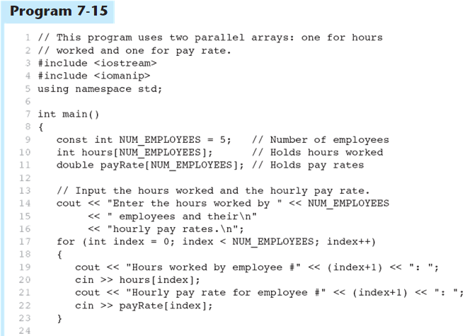
Parallel Arrays in Program 7-15
(Program Continues)

Slide 26
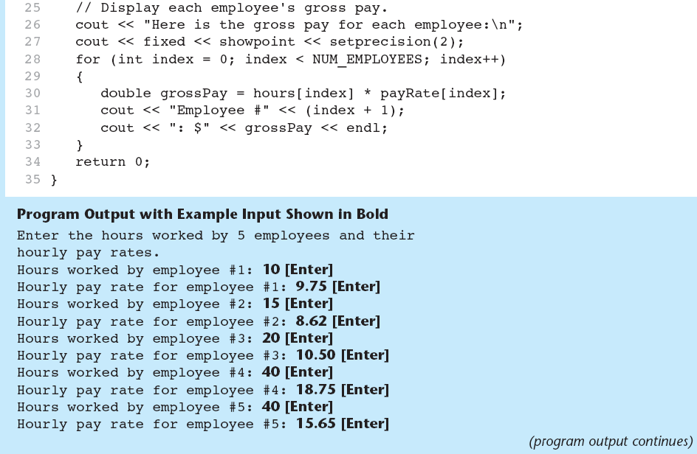
Parallel Arrays in Program 7-15

Slide 27
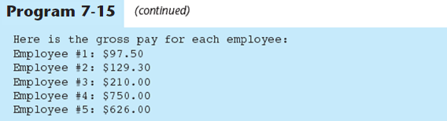
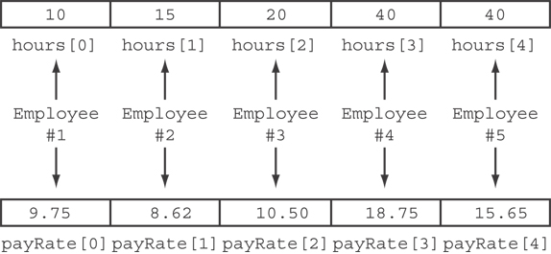
Parallel Arrays in Program 7-15
The hours and payRate arrays are related through their subscripts:

Slide 28
7.8
Arrays as Function Arguments

Slide 29
Arrays as Function Arguments
To pass an array to a function, just use the array name:
  showScores(tests);
To define a function that takes an array parameter, use empty [] for array argument:
  void showScores(int []);
  // function prototype
  void showScores(int tests[])
  // function header

Slide 30
Arrays as Function Arguments
When passing an array to a function, it is common to pass array size so that function knows how many elements to process:
  showScores(tests, ARRAY_SIZE);
Array size must also be reflected in prototype, header:
  void showScores(int [], int);
  // function prototype
  void showScores(int tests[], int size)
  // function header
7-<number>

Slide 31
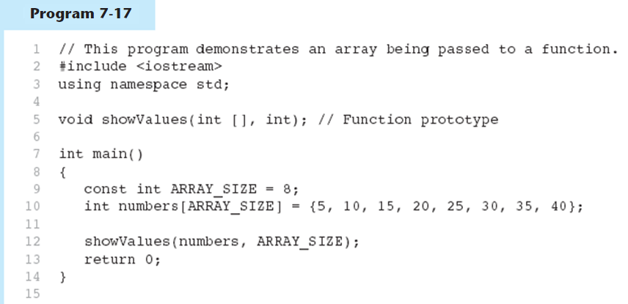
Passing an Array to a Function in Program 7-17
(Program Continues)

Slide 32
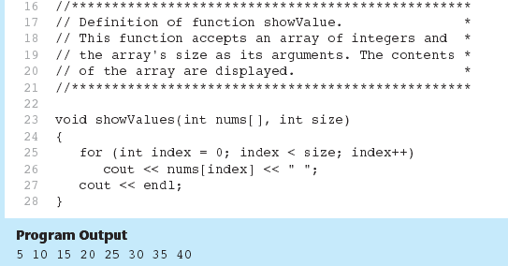
Passing an Array to a Function in Program 7-17

Slide 33
Modifying Arrays in Functions
Array names in functions are like reference variables – changes made to array in a function are reflected in actual array in calling function
Need to exercise caution that array is not inadvertently changed by a function

Slide 34
7.9
Two-Dimensional Arrays

Slide 35
Two-Dimensional Arrays
Can define one array for multiple sets of data
Like a table in a spreadsheet
Use two size declarators in definition:
  const int ROWS = 4, COLS = 3;
  int exams[ROWS][COLS];
First declarator is number of rows; second is number of columns

Slide 36
Two-Dimensional Array Representation
const int ROWS = 4, COLS = 3; int exams[ROWS][COLS];
Use two subscripts to access element:
  exams[2][2] = 86;
columns
exams[0][0] | exams[0][1] | exams[0][2]
exams[1][0] | exams[1][1] | exams[1][2]
exams[2][0] | exams[2][1] | exams[2][2]
exams[3][0] | exams[3][1] | exams[3][2]
r
o
w
s

Slide 37
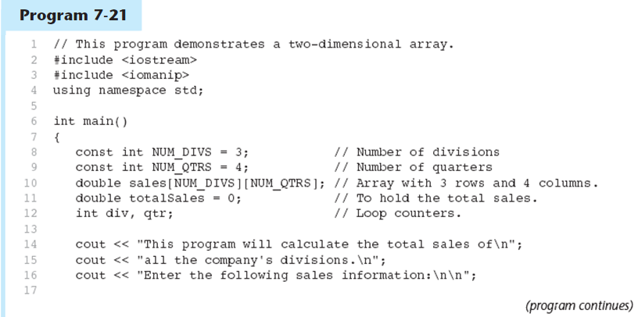
A Two-dimensional Array in Program 7-21

Slide 38
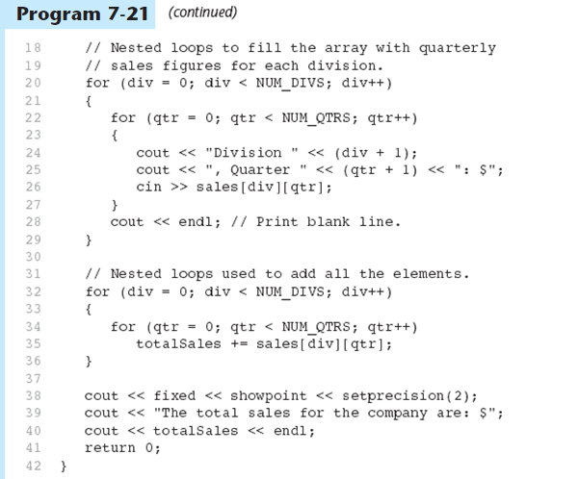
A Two-dimensional Array in Program 7-21

Slide 39
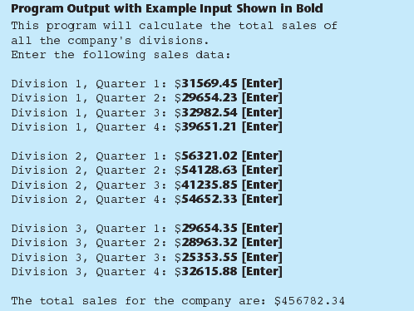
A Two-dimensional Array in Program 7-21

Slide 40
2D Array Initialization
Two-dimensional arrays are initialized row-by-row:
const int ROWS = 2, COLS = 2;
int exams[ROWS][COLS] = { {84, 78},
  {92, 97} };
Can omit inner { }, some initial values in a row – array elements without initial values will be set to 0 or NULL
84 | 78
92 | 97

Slide 41
Two-Dimensional Array as Parameter, Argument
Use array name as argument in function call:
  getExams(exams, 2);
Use empty [] for row, size declarator for column in prototype, header:
const int COLS = 2;
// Prototype
void getExams(int [][COLS], int);
// Header
void getExams(int exams[][COLS], int rows)

Slide 42
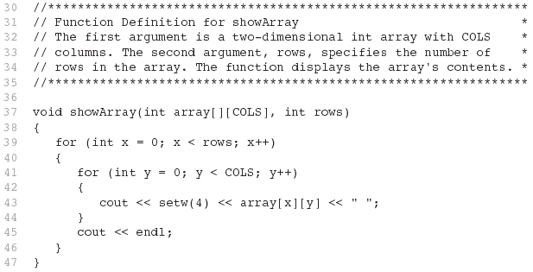
Example – The showArray Function from Program 7-22

Slide 43
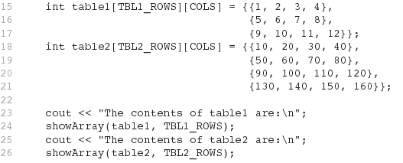
How showArray is Called

Slide 44
Summing All the Elements in a Two-Dimensional Array
Given the following definitions:
const int NUM_ROWS = 5; // Number of rows
const int NUM_COLS = 5; // Number of columns
int total = 0; // Accumulator
int numbers[NUM_ROWS][NUM_COLS] =
{{2, 7, 9, 6, 4},
{6, 1, 8, 9, 4},
{4, 3, 7, 2, 9},
{9, 9, 0, 3, 1},
{6, 2, 7, 4, 1}};

Slide 45
Summing All the Elements in a Two-Dimensional Array
// Sum the array elements.
for (int row = 0; row < NUM_ROWS; row++)
{
for (int col = 0; col < NUM_COLS; col++)
total += numbers[row][col];
}
// Display the sum.
cout << "The total is " << total << endl;

Slide 46
Summing the Rows of a Two-Dimensional Array
Given the following definitions:
const int NUM_STUDENTS = 3;
const int NUM_SCORES = 5;
double total; // Accumulator
double average; // To hold average scores
double scores[NUM_STUDENTS][NUM_SCORES] =
{{88, 97, 79, 86, 94},
{86, 91, 78, 79, 84},
{82, 73, 77, 82, 89}};

Slide 47
Summing the Rows of a Two-Dimensional Array
// Get each student's average score.
for (int row = 0; row < NUM_STUDENTS; row++)
{
// Set the accumulator.
total = 0;
// Sum a row.
for (int col = 0; col < NUM_SCORES; col++)
total += scores[row][col];
// Get the average
average = total / NUM_SCORES;
// Display the average.
cout << "Score average for student "
<< (row + 1) << " is " << average <<endl;
}

Slide 48
Summing the Columns of a Two-Dimensional Array
Given the following definitions:
const int NUM_STUDENTS = 3;
const int NUM_SCORES = 5;
double total; // Accumulator
double average; // To hold average scores
double scores[NUM_STUDENTS][NUM_SCORES] =
{{88, 97, 79, 86, 94},
{86, 91, 78, 79, 84},
{82, 73, 77, 82, 89}};

Slide 49
Summing the Columns of a Two-Dimensional Array
// Get the class average for each score.
for (int col = 0; col < NUM_SCORES; col++)
{
// Reset the accumulator.
total = 0;
// Sum a column
for (int row = 0; row < NUM_STUDENTS; row++)
total += scores[row][col];
// Get the average
average = total / NUM_STUDENTS;
// Display the class average.
cout << "Class average for test " << (col + 1)
<< " is " << average << endl;
}

Slide 50
7.10
Arrays with Three or More Dimensions

Slide 51
Arrays with Three or More
Dimensions
Can define arrays with any number of dimensions:
  short rectSolid[2][3][5];
  double timeGrid[3][4][3][4];
When used as parameter, specify all but 1st dimension in prototype, heading:
  void getRectSolid(short [][3][5]);

